Slide 1
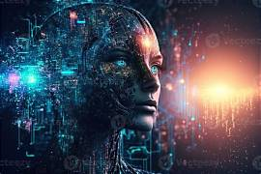
ARTIFICIAL INTELLIGENCE
The future of technology
BY SHIVANGI
DEPARTMENT OF COMPUTER SCIENCE
ALIGARH MUSLIM UNIVERSITY
2026

Slide 2
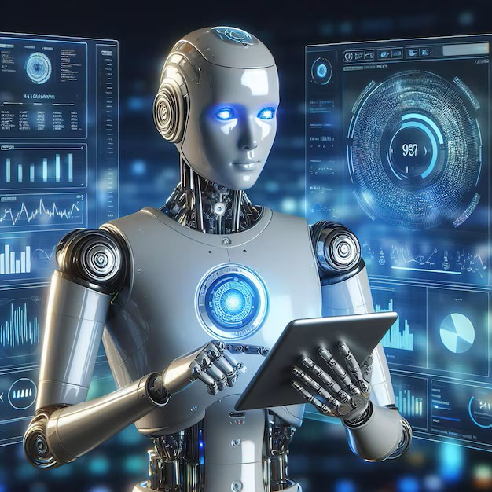
WHAT IS ARTIFICIAL INTELLIGENCE ?
AI Enables computers to perform tasks normally require human intelligence.
It can learn from data and identify patterns .
AI Is used in education, healthcare, banking and transportation.
Example include chatbot, virtual assistance and recommendation system.

Slide 3
APPLICATION OF AI
FIELD | APPLICATION | EXAMPLE
Healthcare | Diagnosis | Medical AI
Education | Personalized learning | AI tutor
Banking | Fraud detection | Smart banking
Transport | Navigation | Self-driving system

Slide 4
GROWTH OF AI

Slide 5
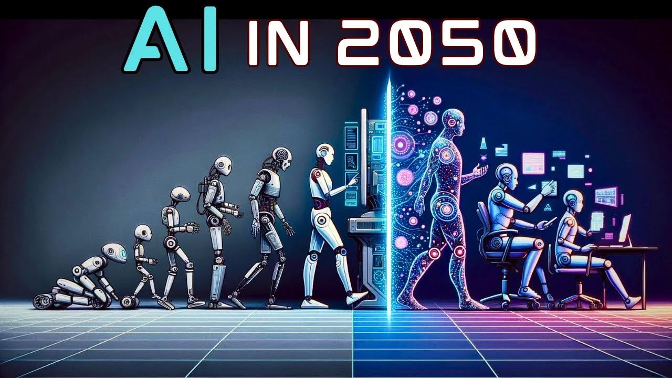
FUTURE OF AI
AI will become increasingly integrated into everyday life.
Automation will transform many industries.
Human-AI collaboration will create new opportunities.
Responsible and ethical use of AI will be important.
Learn more about AI

